Slide 1
Direction change instigation ‘signals’ in Orcinus orca
Nora Carlson

Slide 2
Introduction
Clicks
  Echolocation
  Clicks, Click Trains and Buzzes
Whistles
  Foraging, Socializing, >10m
  Reich & Thomson
Discrete Pulsed Calls
  Maintain Contact, Group Identity
  Bigg & Ford

Slide 3
Visibility, Vocal Communication and Group Movement
White Faced Capuchin Monkeys
  Boinski 1993, 2006
Salish Sea

Slide 4
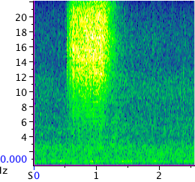

Materials and Methods
Data sources
  Lime Kiln/Dr. Otis
  Gato Verde
Data Gathered
  Calls
    pulsed calls
    whistles
  Buzzes
    independent
    continuous
  Direction Changes
    90°-180°

Slide 5
Call Rate
(t = 2.06, N = 26, p = 0.60)

Slide 6
Buzz Rate

Slide 7
Discussion
Call Rates
  Historical lack of behavioral correlation
  Simple/complicated
  Focusing on irrelevant differences
Buzz Rates
  Clicks and Buzzes
  Shared information (Barrett-Lennard)
  Occurrence in discrete pulsed calls

Slide 8
Limitations of Study
Sample Size
Limited Visibility
Human Error
  Data Entry

Slide 9
Areas for Further Study
Direction Change Instigation
  Clicks and Buzzes
  Group Decision Making & Cohesion
  Pod Dispersal
Communicative Function
  Occurrence in ‘conversational bouts’

Slide 10
Thank You
Beam Reach
  Dr. Jason Wood
  Dr. Val Veirs
  Dr. Scott Veirs
  Capt. Todd Shuster
  Kathryn, Libby and Horace
University of Washington Friday Harbor Labs
Lynn Weber/Roochvarg
Dr. Robert Otis
Ken Balcomb

