Slide 1
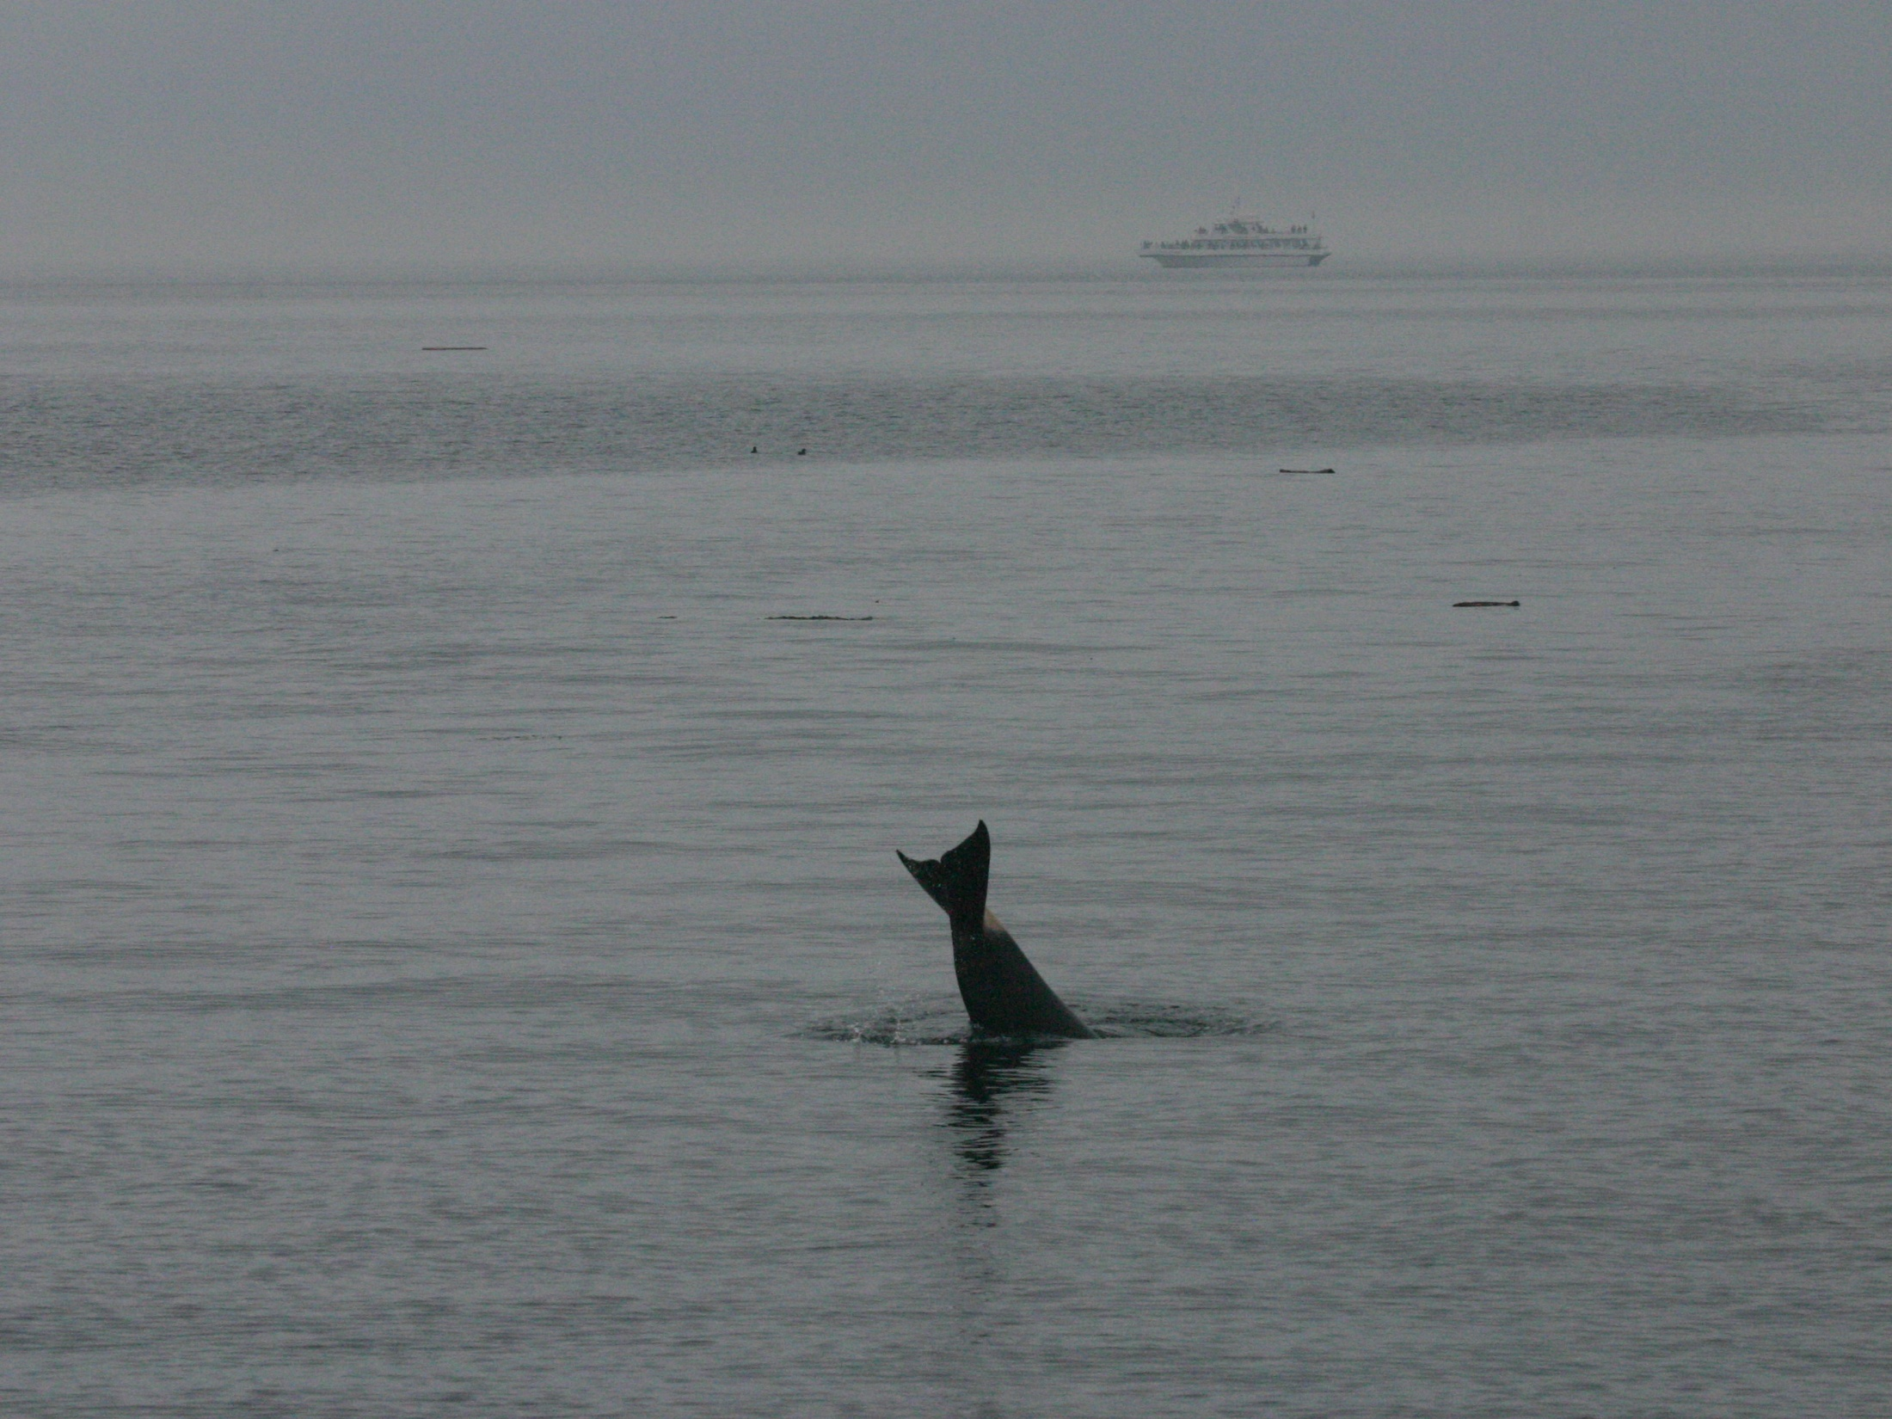
Changes in the frequency structure of echolocation clicks across behavioral states in Southern Resident killer whales (Orcinus orca)
Garrett Turner
Beam Reach Marine Science and Sustainability School
gjt2@u.washington.edu

Slide 2
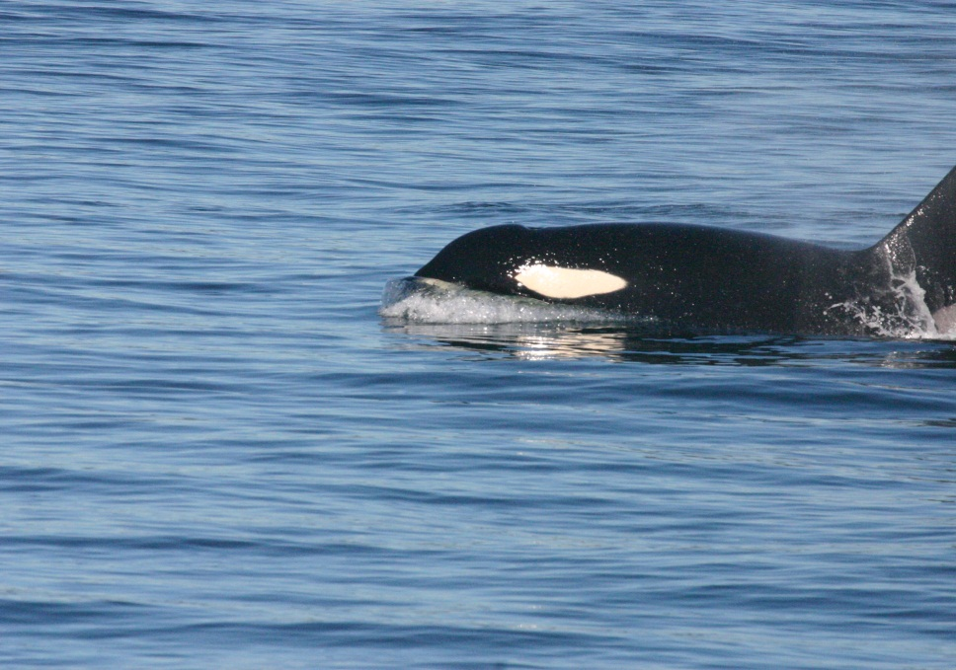
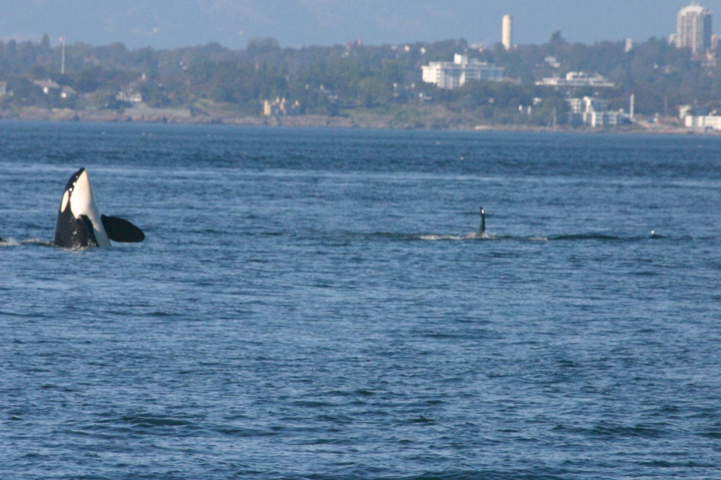
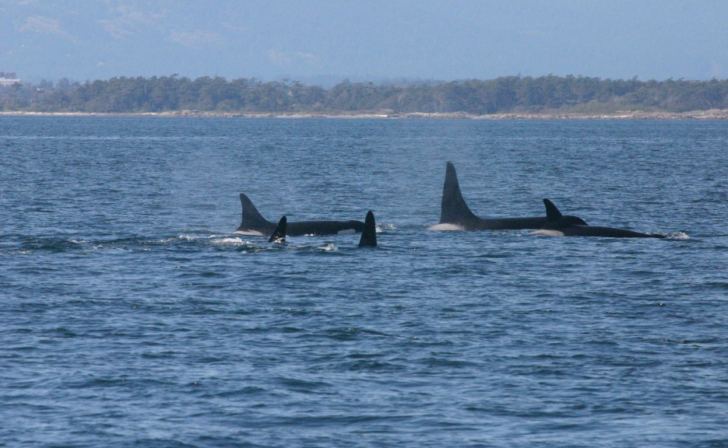
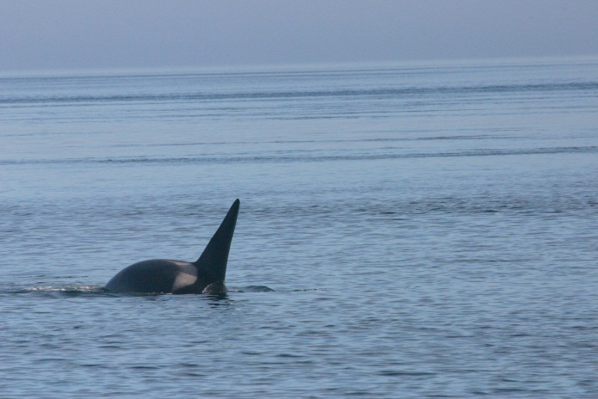
Background Information:
Killer whales are known to produce echolocation clicks during various behavior states, and it is assumed that they were used primarily for hunting salmon and navigation.
Behavior states:
Foraging
Traveling
Milling
Socializing
Resting
Type of Clicks:
Single clicks
Click trains

Slide 3
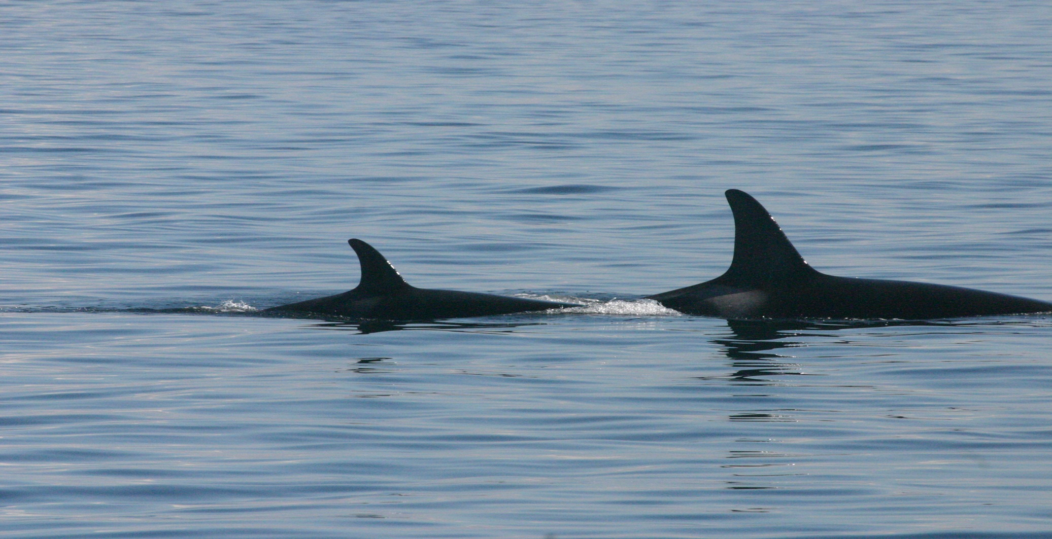
Hypothesis:
I predicted variations would be found in the frequency structures of echolocation clicks across different behavior states.

Slide 4
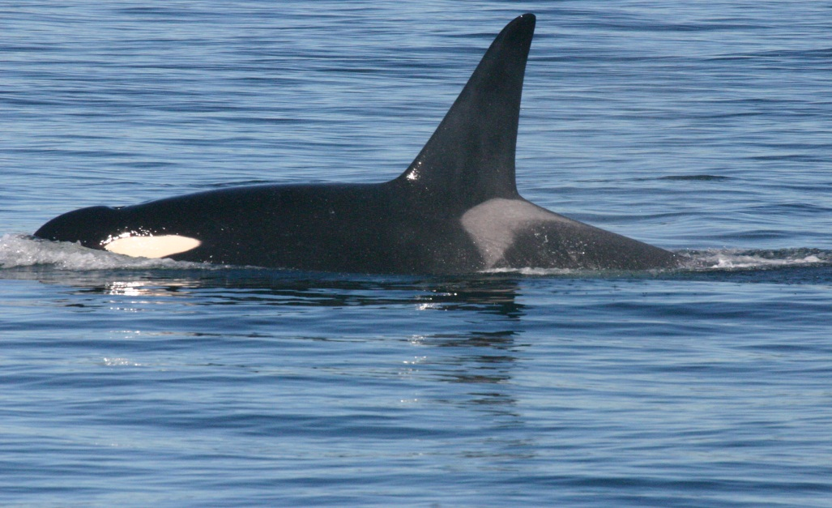
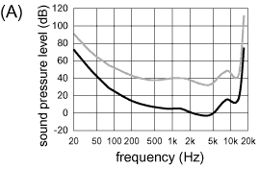
Differences in Hearing Sensitivities
Whales can here frequencies higher than 100 kHz
Humans can only hear up to 20 kHz
Hearing Sensitivity for Humans
Hearing Sensitivity for Killer Whales

Slide 5
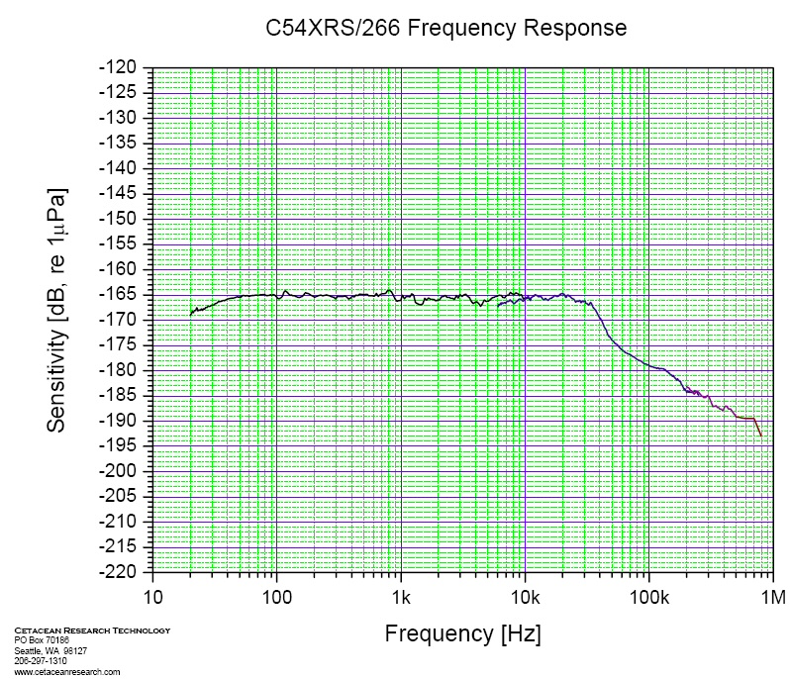
Data Collection:
Recording Clicks:
Behavioral data was collected with respect to the five defined behavior states
We had five hydrophones deployed
I only used recordings from the CRT hydrophone.
The CRT is more sensitive to higher frequencies which is very important when you are looking at echolocation clicks.
On Axis Clicks:
Clicks that are off axis become distorted, and in order to control for this observational data was collected on the orientation of the whales with respect to the boat.

Slide 6
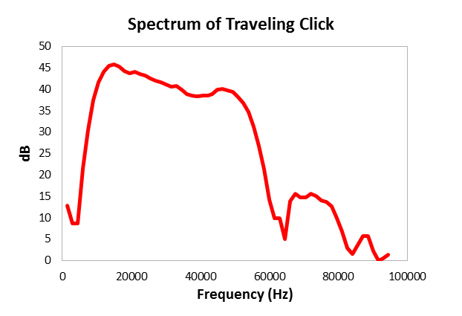
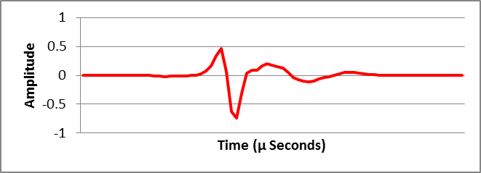
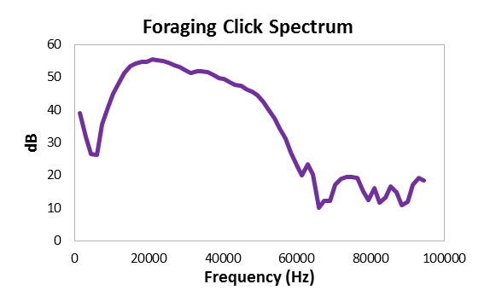
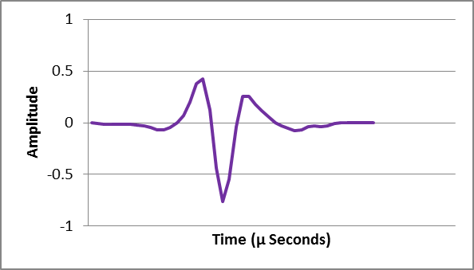
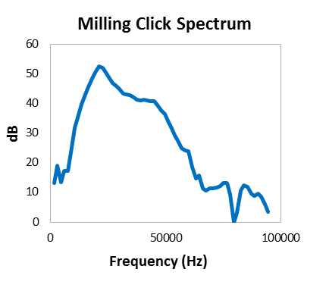
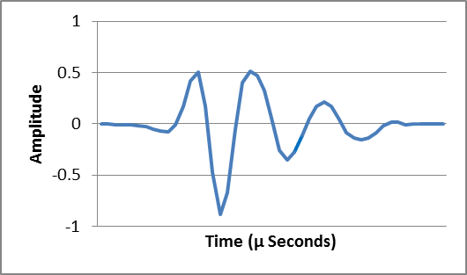

Examples of Click Spectra and Wave Forms
400 µ Seconds
286 µ Seconds

Slide 7
Click Measurements
Center frequency: Is the frequency value that splits the energy from the spectrum into two equal parts
RMS Bandwidth: The RMS bandwidth is used to describe the spectral standard deviation around the center frequency of the spectrum
Q-Value: Q-values are used to describe the overall frequency structure of clicks with respect the center frequency and the RMS bandwidth.
Q-value = Center Frequency / RMS Bandwidth
High Q-values: Correspond with a sharp and narrow spectrum
Low Q-values: Correspond with a broad and wide spectrum

Slide 8
Results:
Significant: Foraging vs. Milling
and Traveling vs. Milling
Significant: Foraging vs. Milling

Slide 9
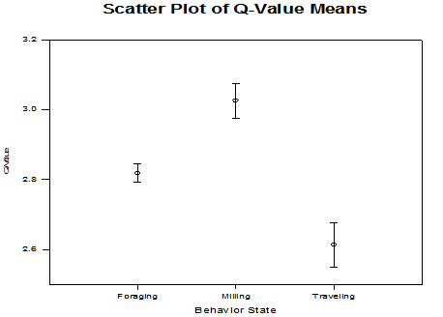
Results:
Q-values for all three behaviors were significantly different from each other

Slide 10
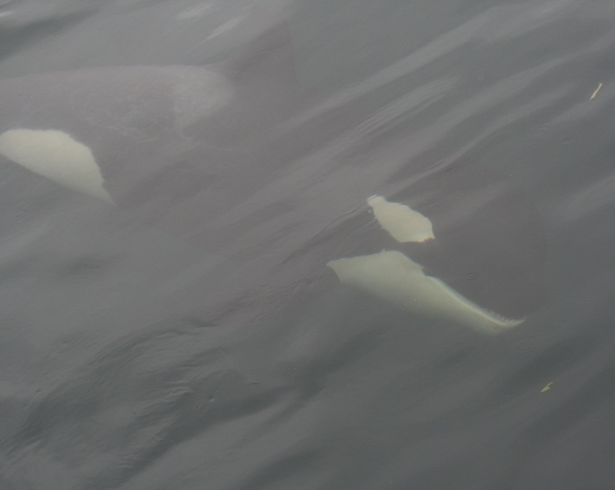
Discussion:
This study shows killer whales are able to actively control the frequency of their clicks for specific tasks and situations, this has may have important implications including:
Ability to avoid masking due to ambient noise?
Could be used as an empirical measurement of behavior states
Social meaning
Functional differences
It is still unknown what the whales are doing under water, and the different structures suggest the clicks are being used for specific tasks during various behavior states

Slide 11
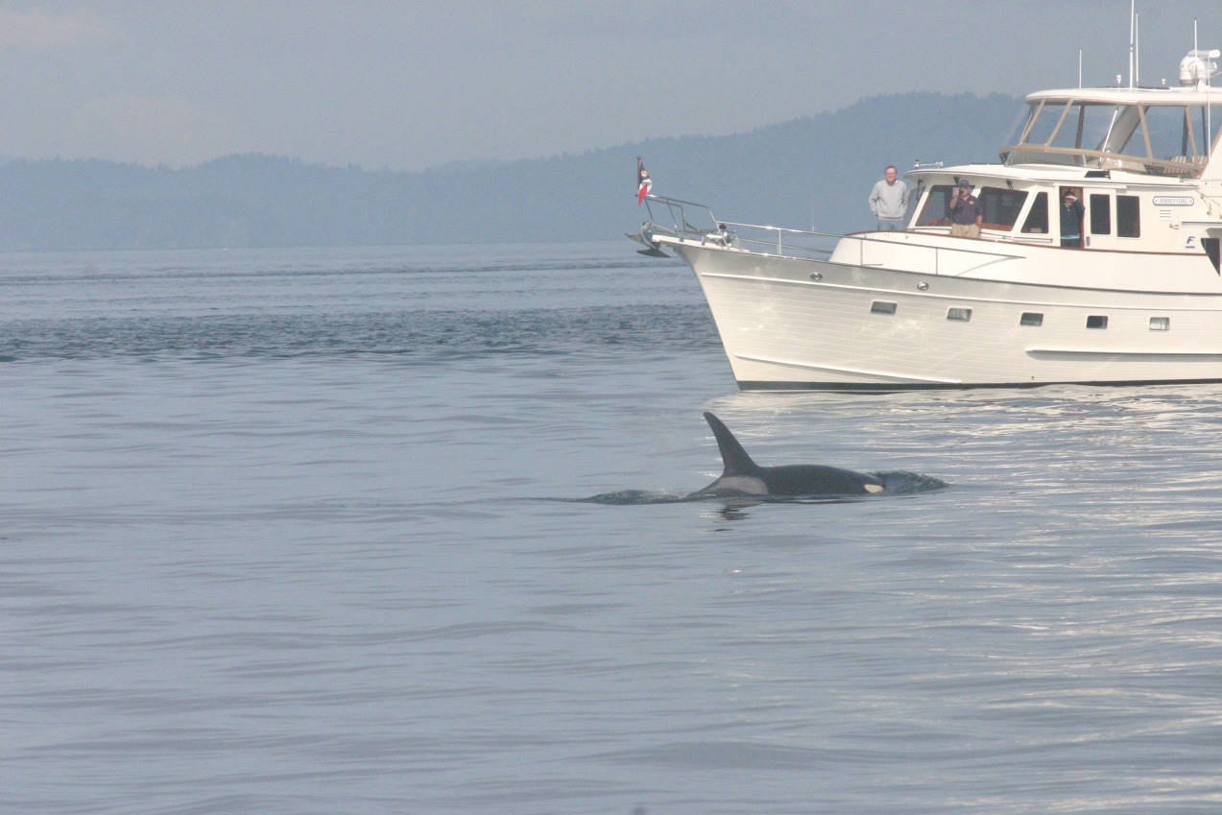
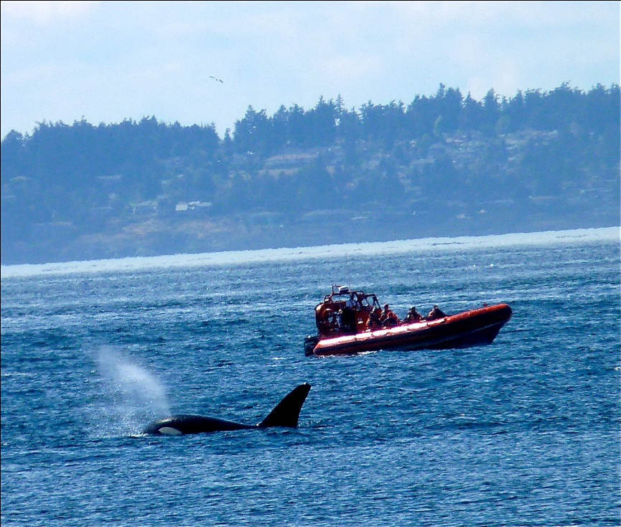
Future Studies:
More behavioral data should be collected in order to strengthen the results of this study.
Ambient noise is also a continuing problem for the SRKW, and more information is needed for how well killer whales can avoid masking.
Further click frequency studies should also compare click structures across individual whales, pods, ecotypes, and males vs. females

Slide 12
Possible Sources of Error:
Analyzing the data by hand for on axis clicks
Due to the high amplitudes of clicks many of the phonations were clipped which limited my sample size
Human error while classifying the behavioral state.
Possible equipment limitations (sensitivity of the hydrophone)

Slide 13
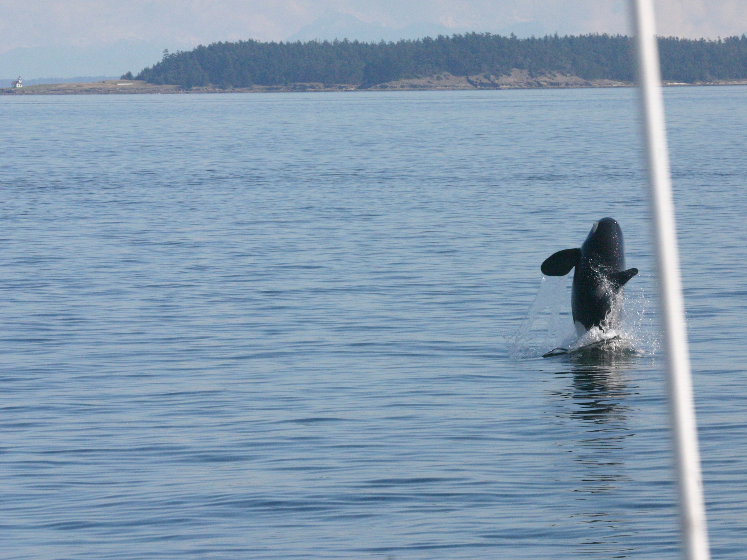
Acknowledgements:
I would like to thank Jason Wood, Val Veirs, and Scott Veirs for supporting our program and research over the last 10 weeks.
Thank you to everyone that provided information on the location of the whales.
Thank you to Vanessa, Dave, Cat, Megan, and Hana for an amazing program.
Thank you to Todd Shuster for giving us the opportunity to study and learn aboard the Gato Verde.

Slide 14
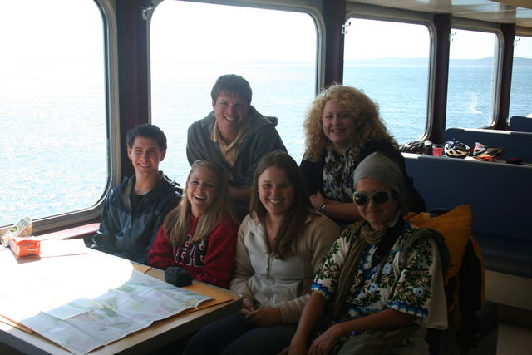
Questions??

