Slide 1
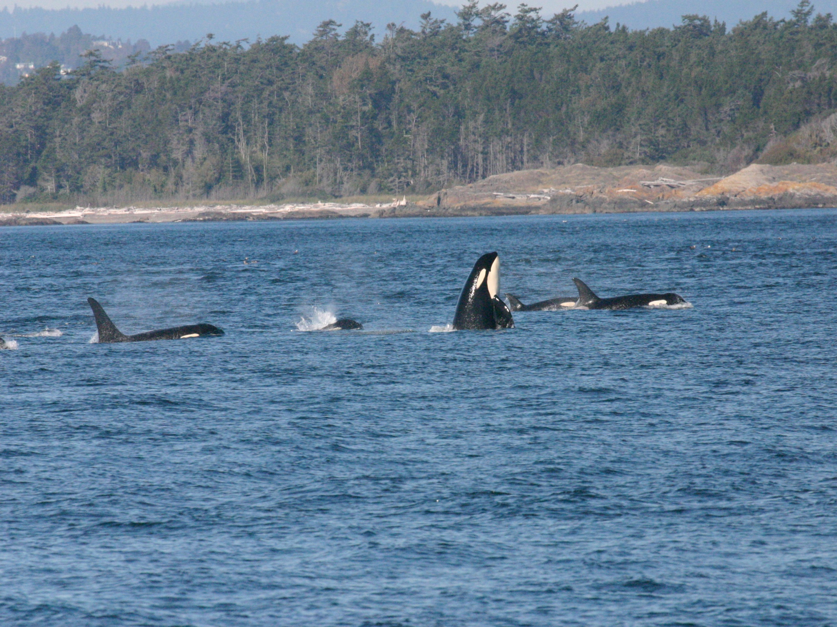
Killer whale (Orcinus orca) echolocation click rates during various behavioral states and ambient noise levels
Hana Kazunas
Beam Reach School of Marine Science and Sustainability
kazunash@carleton.edu

Slide 2
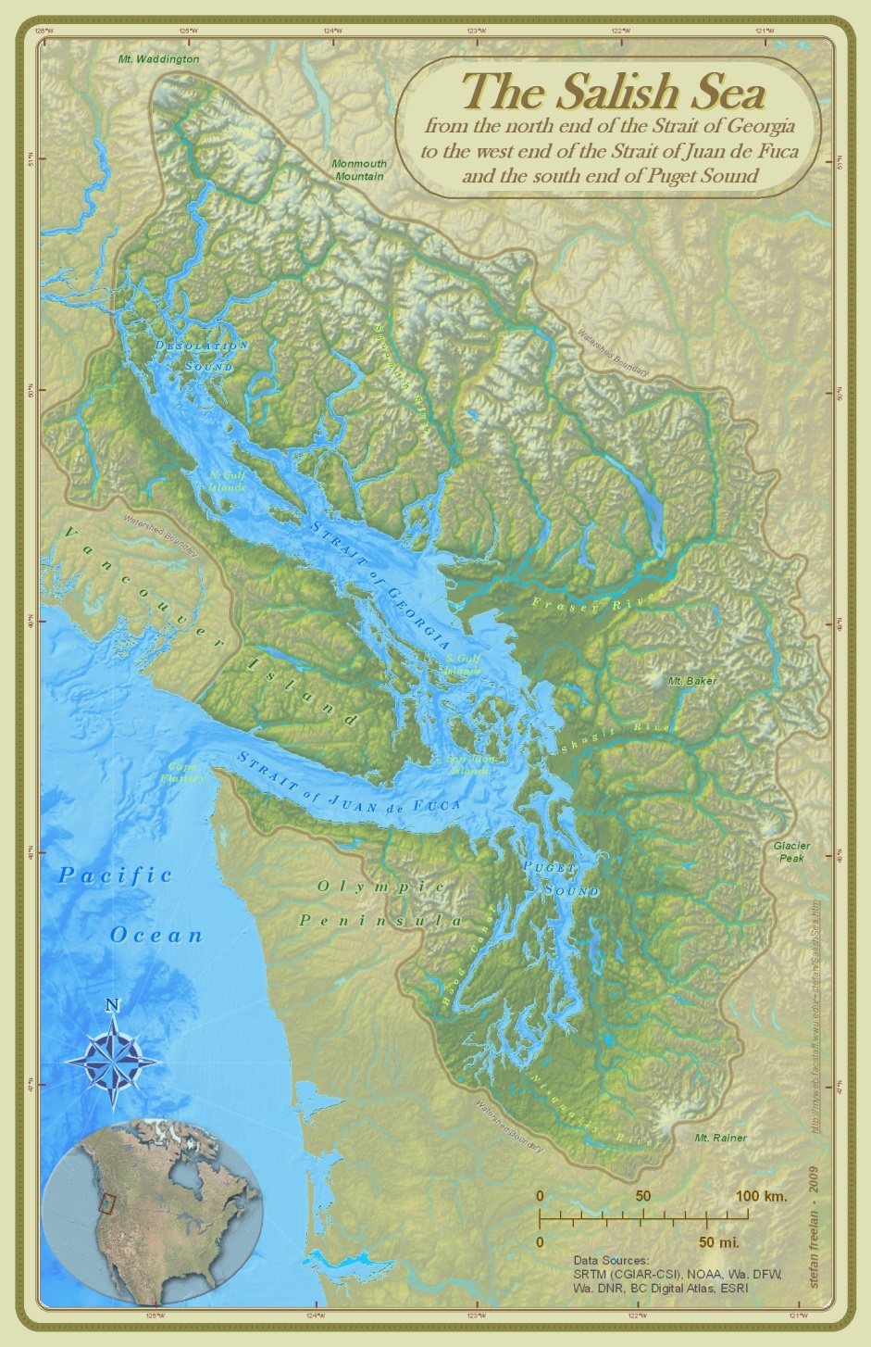
Background
Transients
  Marine-mammal eating
  Less vocal
Southern Residents
  Subpods: J, K, L
  Fish-eating
  Highly vocal
  Endangered species
Northern Residents

Slide 3
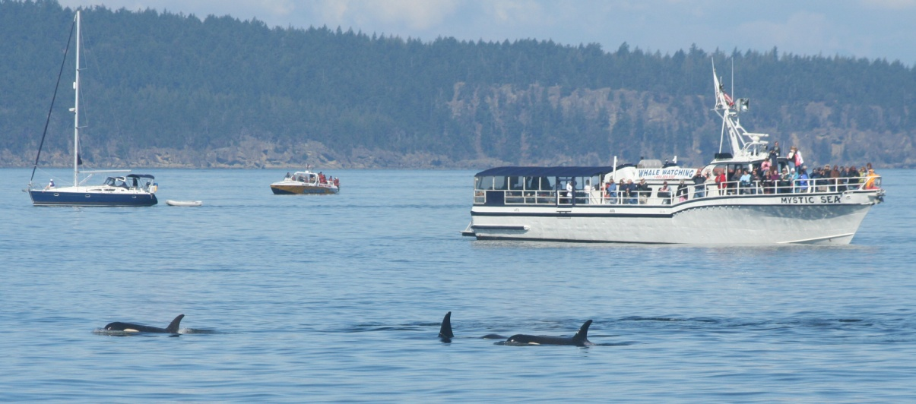
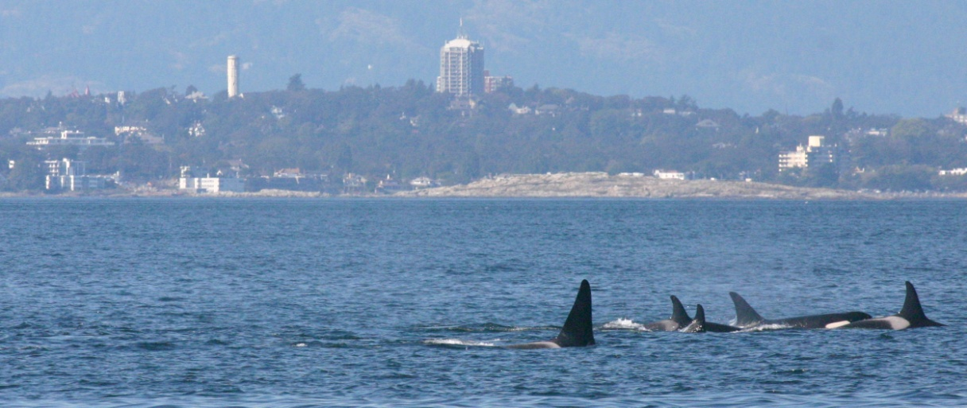
So what?
Inadequate nutrition
  Decline in prey population
Chronic Stress
  Vessel impacts
  Toxin buildup
Declining population size

Slide 4
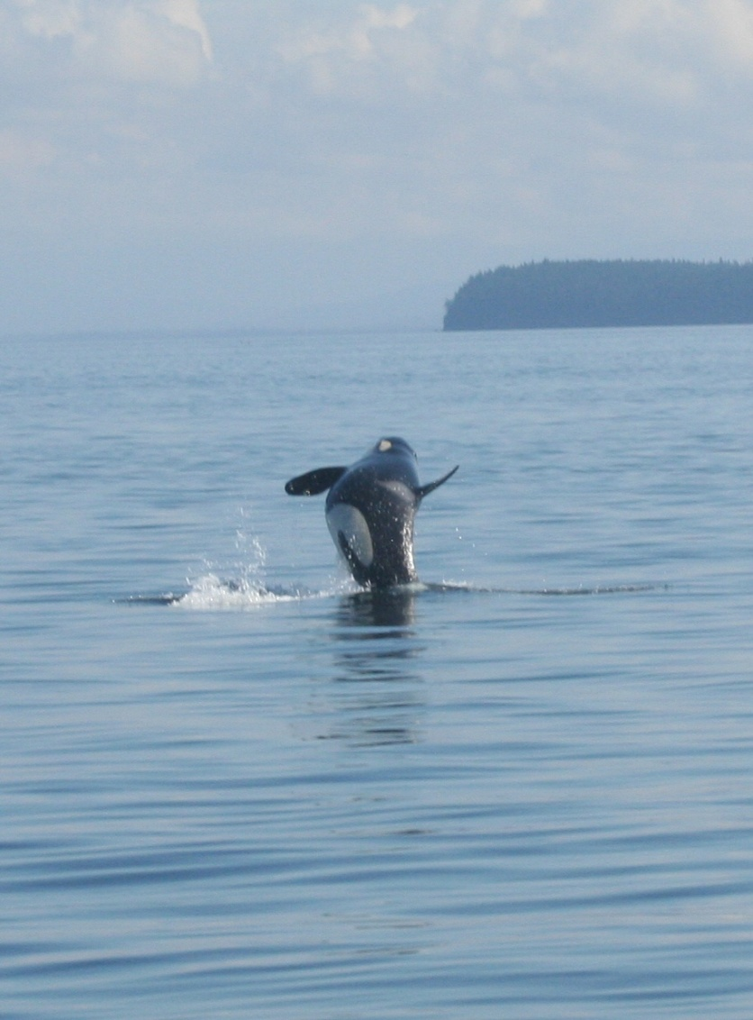
Echolocation
Directional sounds with:
  High amplitude
  Broadband frequency structure
  Short duration
Single or train formation
Used for:
  Navigation
  Prey location

Slide 5
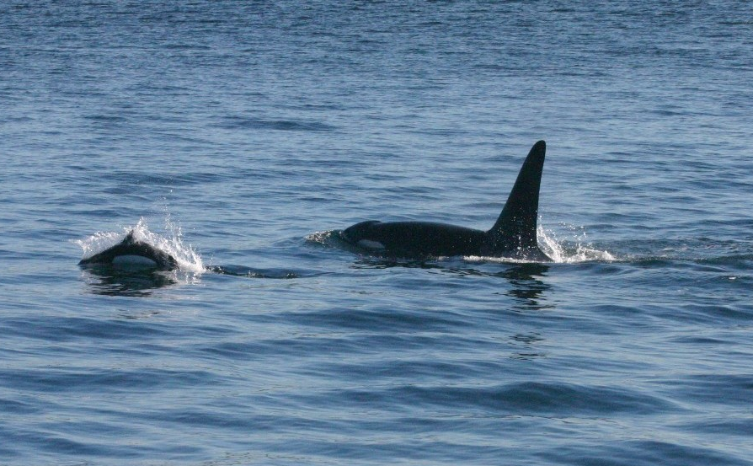
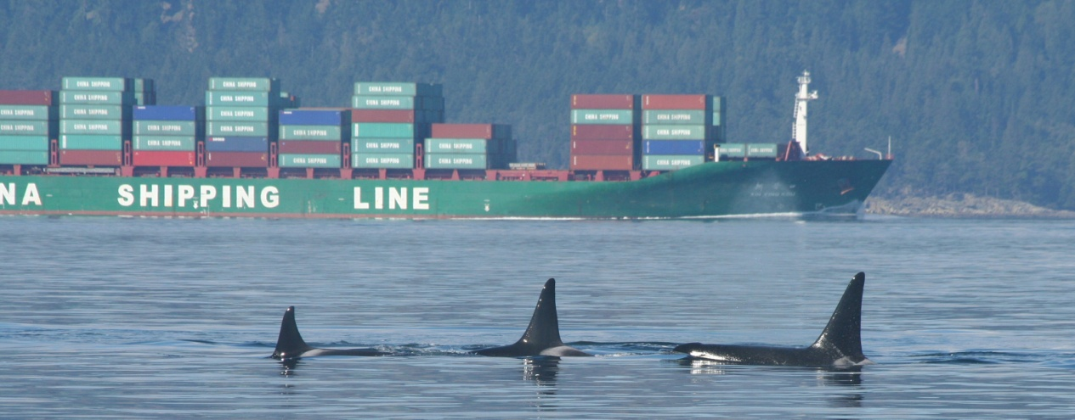
Hypotheses
Click rate will increase as ambient noise increase
Click rates will change across behavior states; foraging and traveling will have the highest rates

Slide 6
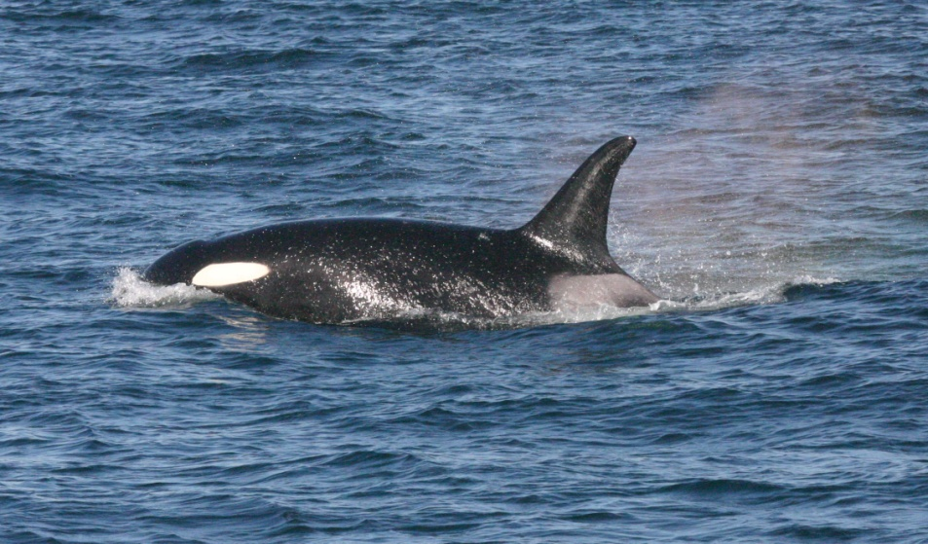
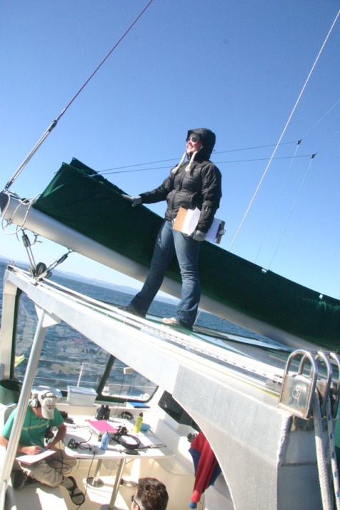
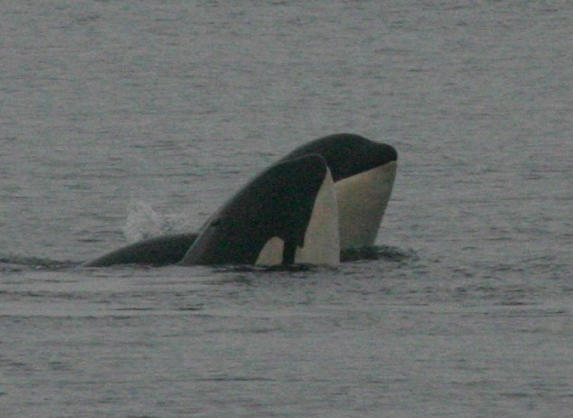
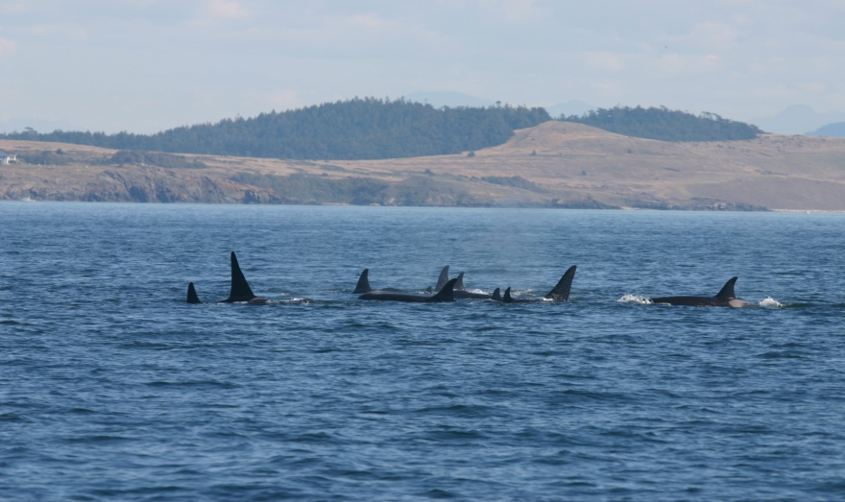
Data Collection
Acoustic recordings made using a hydrophone array and high-frequency hydrophone (CRT)
Record time, behavior state, whale orientation to boat, pod size, interesting notes
Behavior states
  Foraging, milling, resting, socializing, traveling

Slide 7

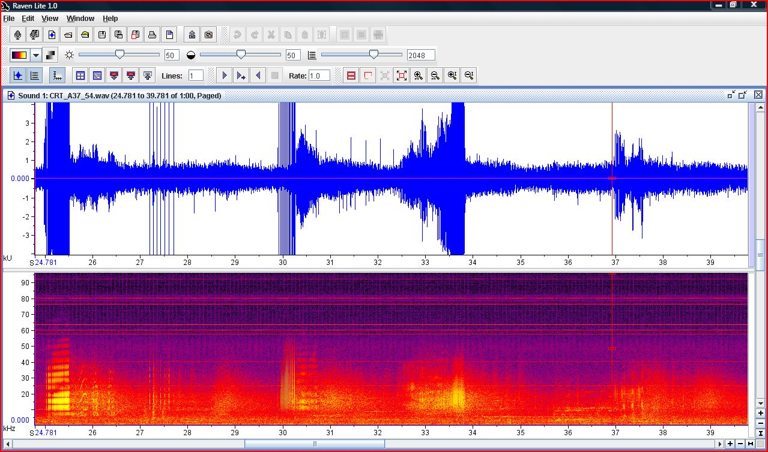
Data Analysis
Count click rate
Compare to ambient noise levels and behavior state

Slide 8
Results: Ambient noise

Slide 9
Results: Ambient noise
Preliminary trend of upper threshold at which click production or detection stops

Slide 10
Results: Behavior States
Statistical significance:
  Foraging and resting, resting and socializing, and resting and traveling

Slide 11
Results: Behavior states
Significant: foraging and resting

Slide 12
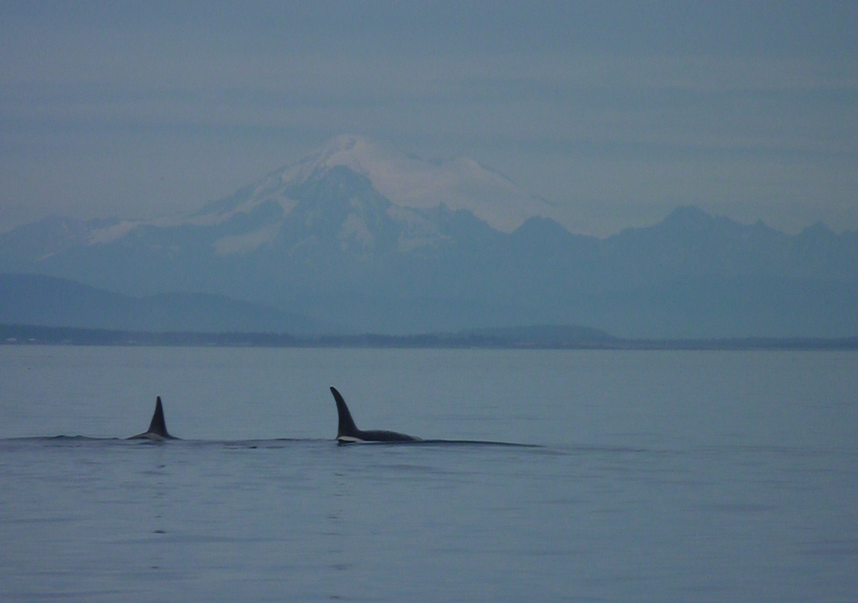
Discussion: Ambient Noise
Inherent difficulty studying masked clicks
Signal-to-Noise ratio
Whales click louder, not faster

Slide 13
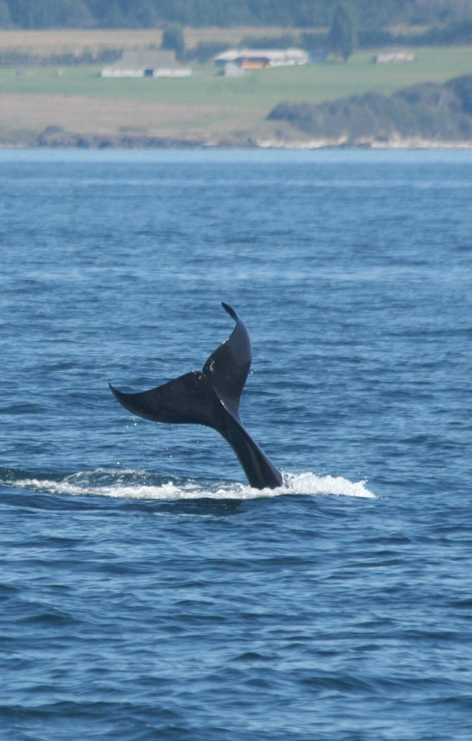
Discussion: Behavior States
Why is foraging low?
  Categorized by sporadic movement
  Whales utilize other foraging techniques
Why is socializing high?
  Possible communicative properties
  Small sample size
Click trains
  Whales zeroing in on target
  Different meaning from single clicks
Notes:
Foraging Low?
Categorized by sporadic movement—whales may have not been oriented properly to hydrophones
Studies of deaf/mute dolphins exist, it may be whales are using other foraging techniques, like visual or auditory cues
Socializing high?
Possible communicative properties
Small sample size
Click trains
Whales zeroing on target (surround habitat or prey). Doesn’t explain why so high in socializing
They mean something different or are used for different purposes than single clicks. More studies needed

Slide 14
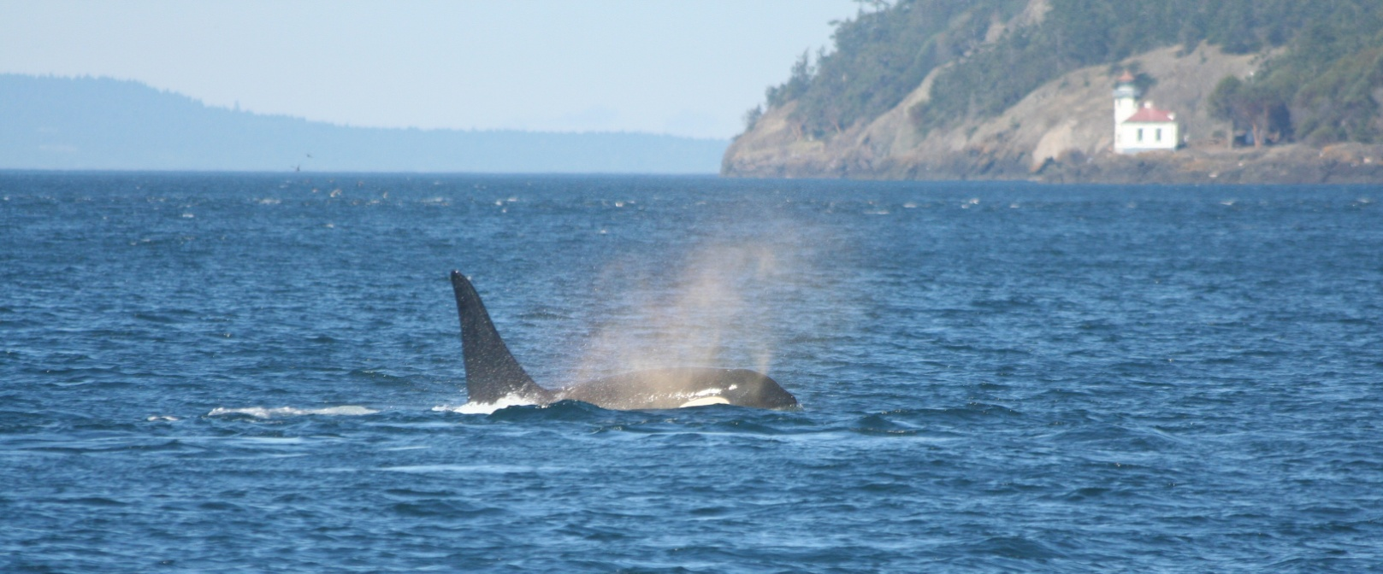
Conclusions
Increased ambient noise levels pose a threat to whales
Different click rates serve different purposes
More significant results would allow for more appropriate guidelines to be set to protect whales

Slide 15
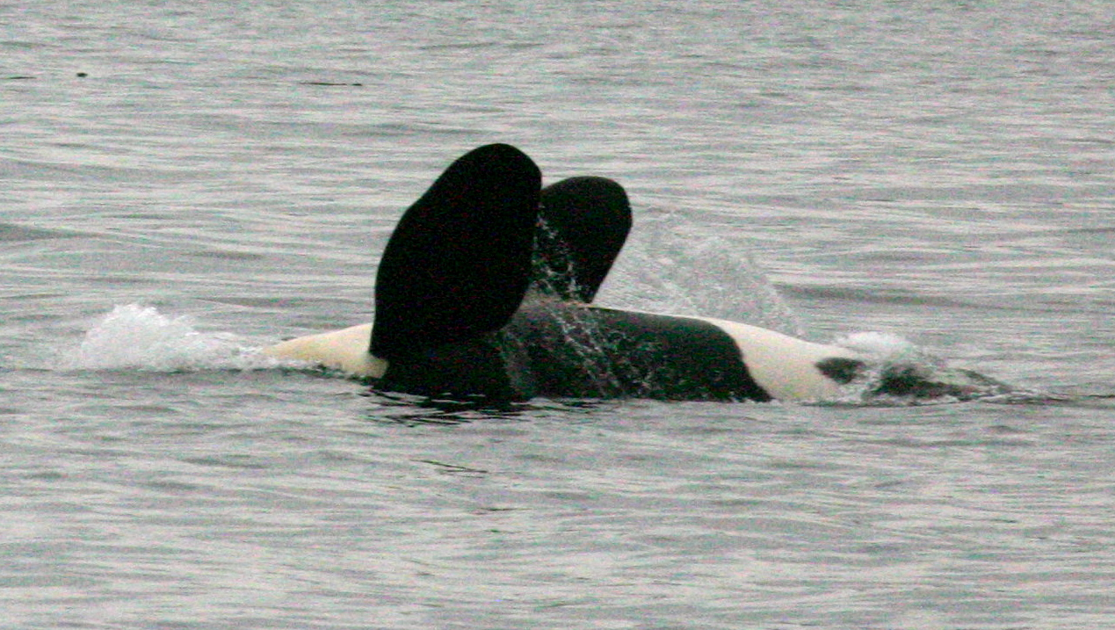
Error
Misidentification of behavior state
Whales not oriented towards hydrophones
Difficulty counting whales
Error counting clicks

Slide 16
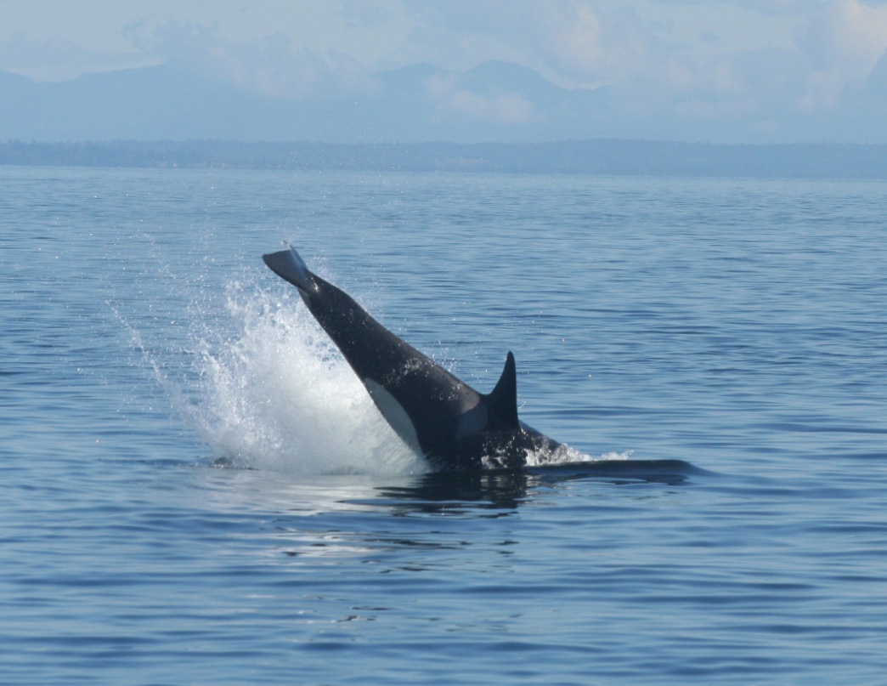
Future Studies
Continuation this study
Ambient noise threshold
Echolocation use at night
Other foraging strategies
Echolocation use in other habitats

Slide 17

Acknowledgements
I would like to extend a big thanks to:
Dr. Jason Wood, Dr. Val Veirs, and Dr. Scott Veirs for continuous support and ever-open office doors
Captain Todd Shuster for keeping Beam Reach safe and sustainable on the water
Everyone who helped Beam Reach find the whales this term
Cat Peters, Megan Stoltzfus, Garrett Turner, Dave Cade and Vanessa Victoria for your cheer, effort and enthusiasm (and body heat)
The whales, just for being there

Slide 18
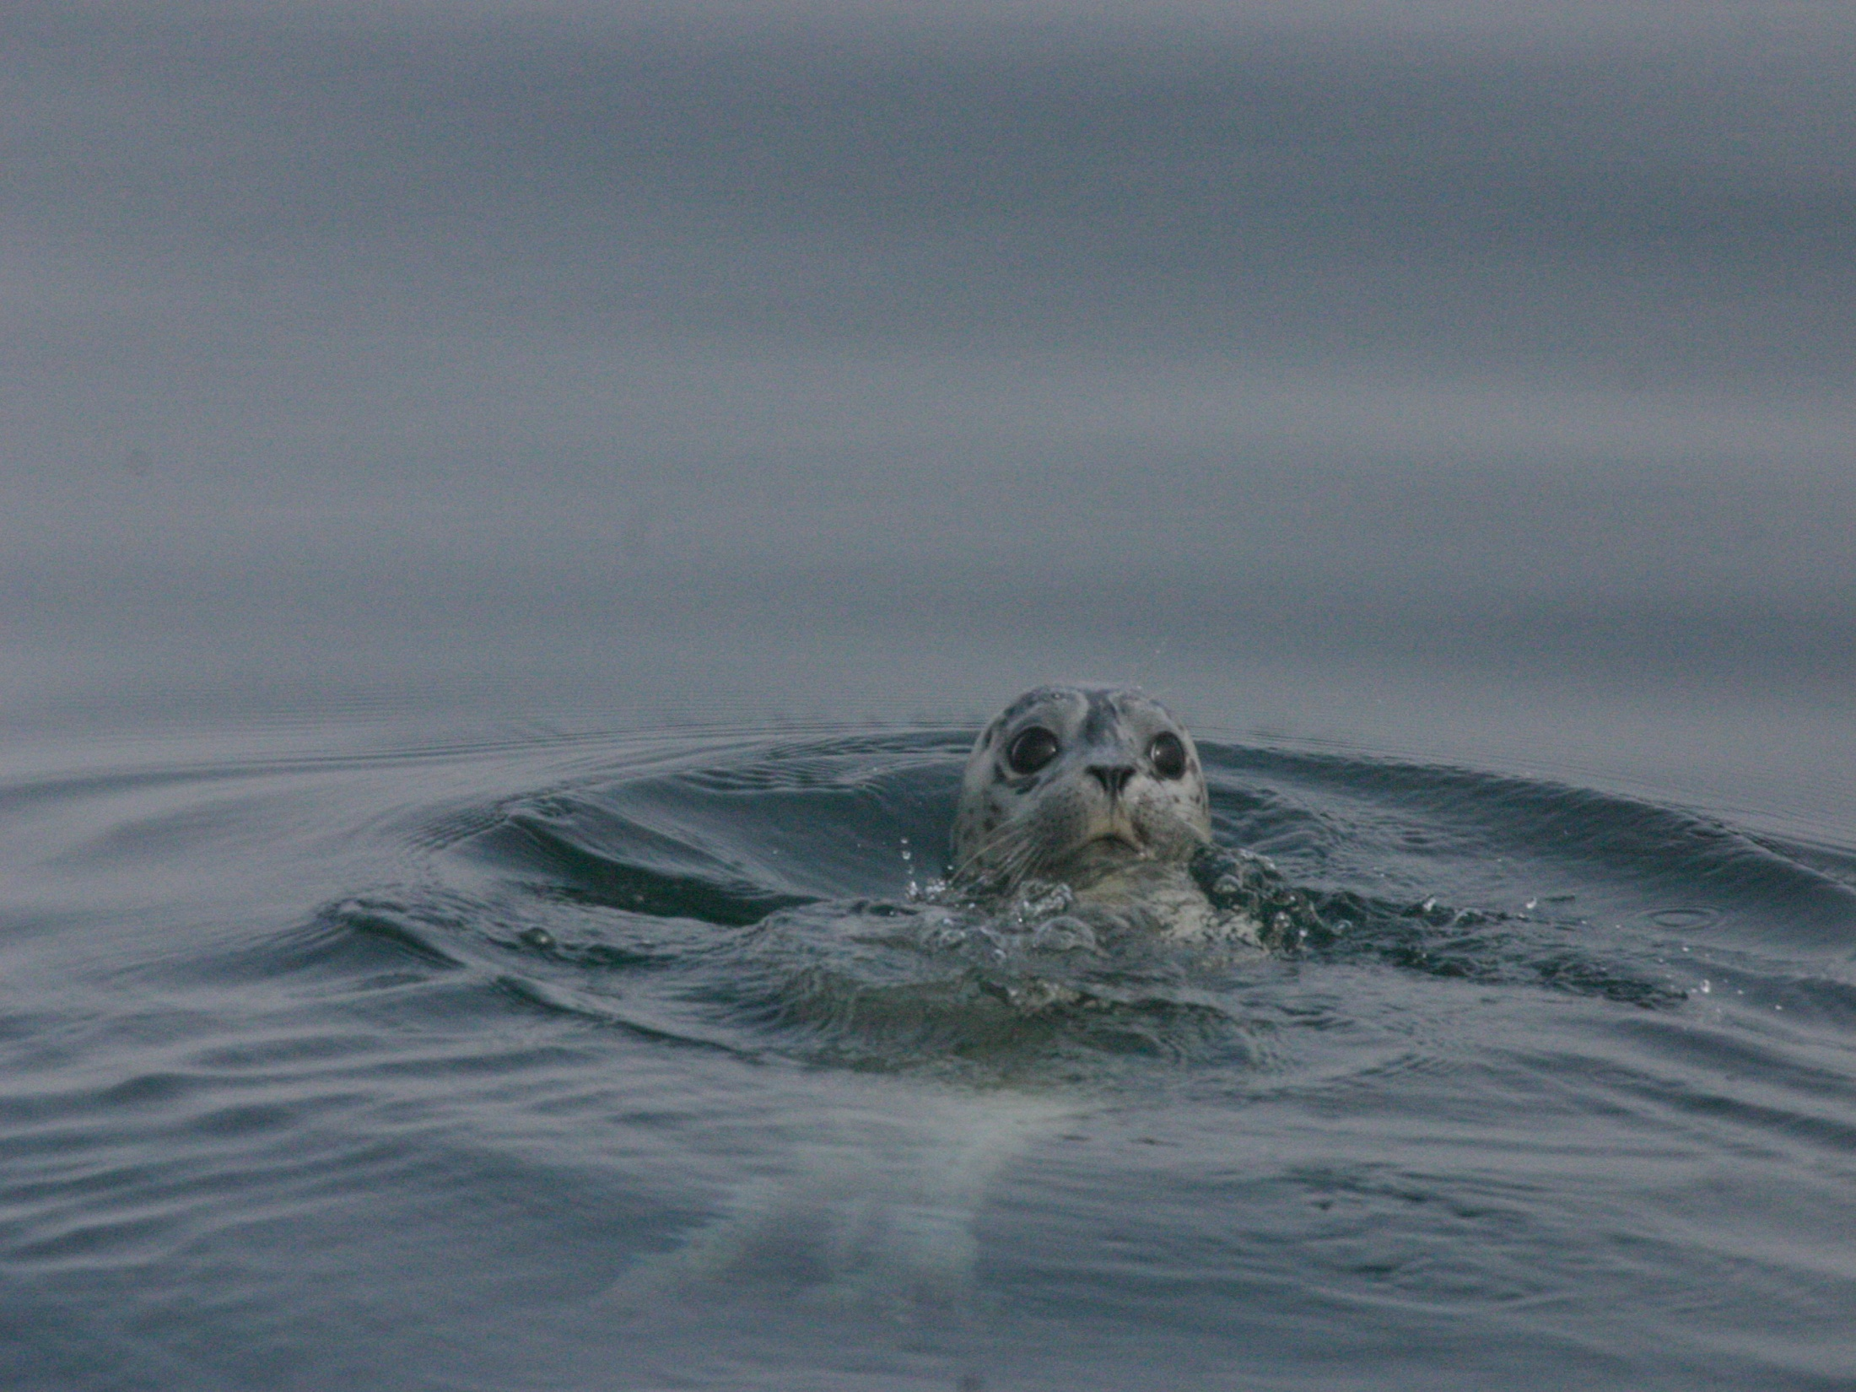
Questions?

