Slide 1
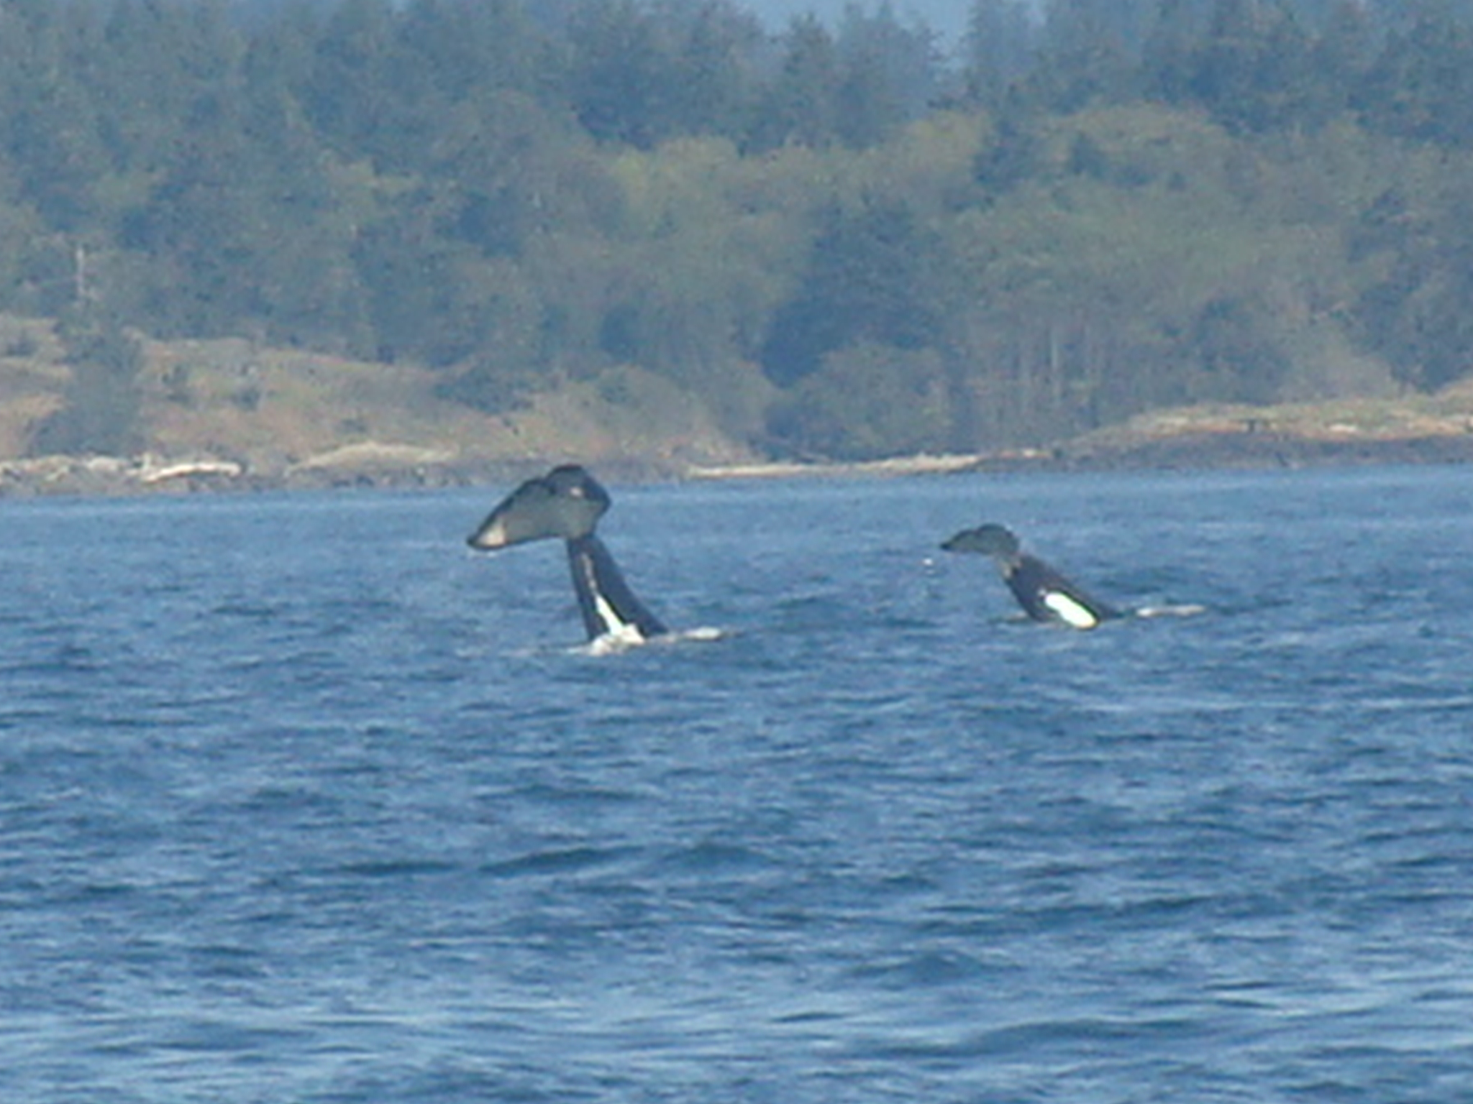
Comparing Vocalizations between Matrilines of Southern Resident Killer Whales (Orcinus orca)
Megan Stoltzfus
Beam Reach Fall 2010
meganls@hawaii.edu

Slide 2
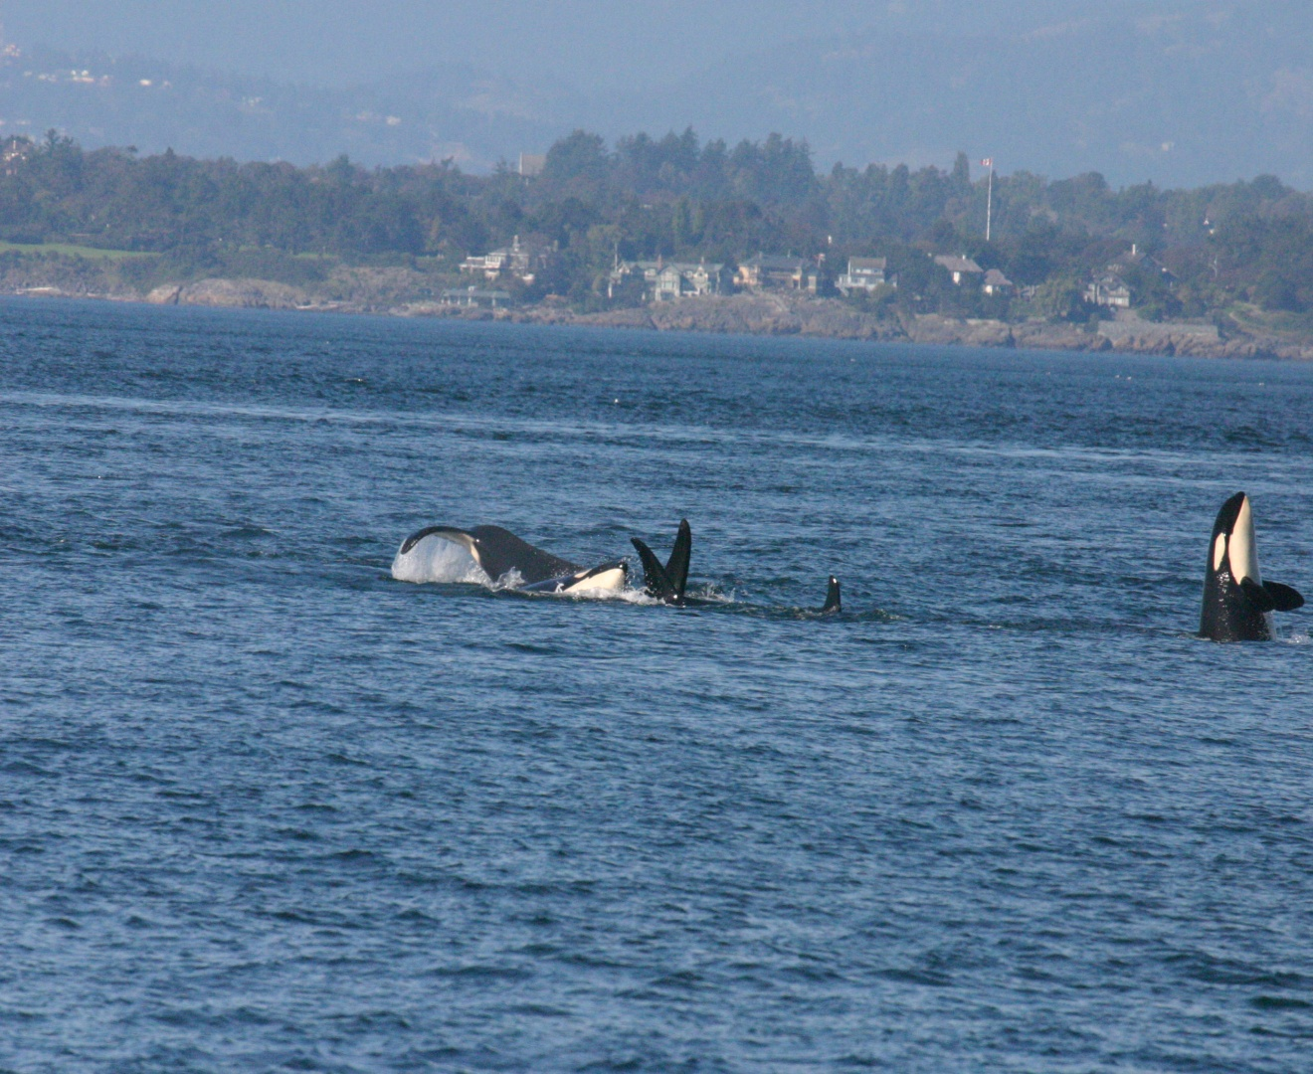
Southern Resident Community
Clan:
J
Pods:
J Pod (27 members)
K Pod (19 members)
L Pod (41 members)
Matrilines:
J-4 Matrilines
K- 4 Matrilines
L-12 Matrilines
Notes:
Matrilines are
Contain 1-17 individuals spanning over 5 generations
More cohesion than pods, rarely separating from each other for more than a few hours

Slide 3
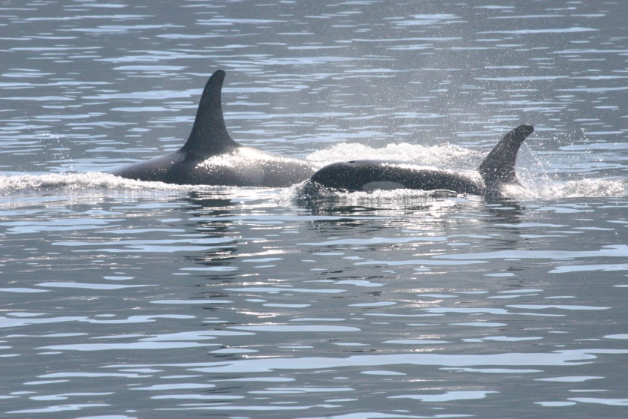
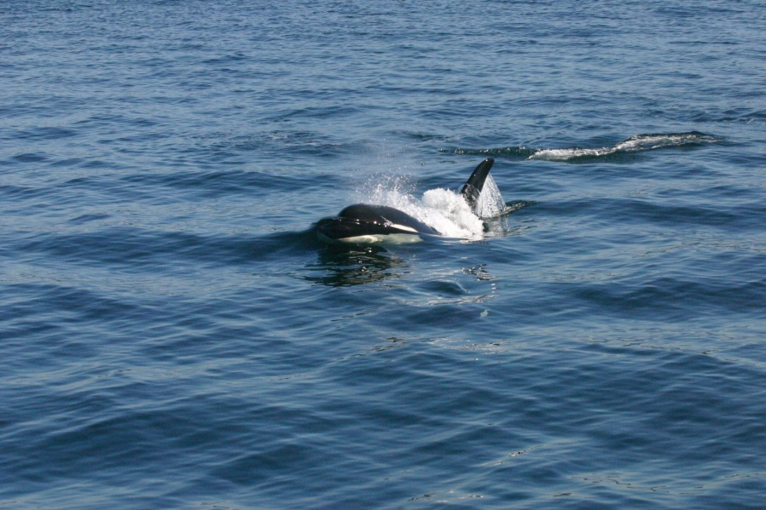
Vocalizations
Clicks, Whistles, and Pulsed Calls
  Pulsed calls consist of 3 types
    Variable- most uncommon
    Aberrant-calls that are non-repeated vocalizations
    Discrete- most common; used while foraging and traveling and maintaining acoustical contact with each other.
Notes:
Vocalizations are very important to these animals used in communication, foraging, and navigation.
3 types of vocalization
I will be focusing on pulsed calls, within pulsed calls there are 3 different types
Variable:

Slide 4
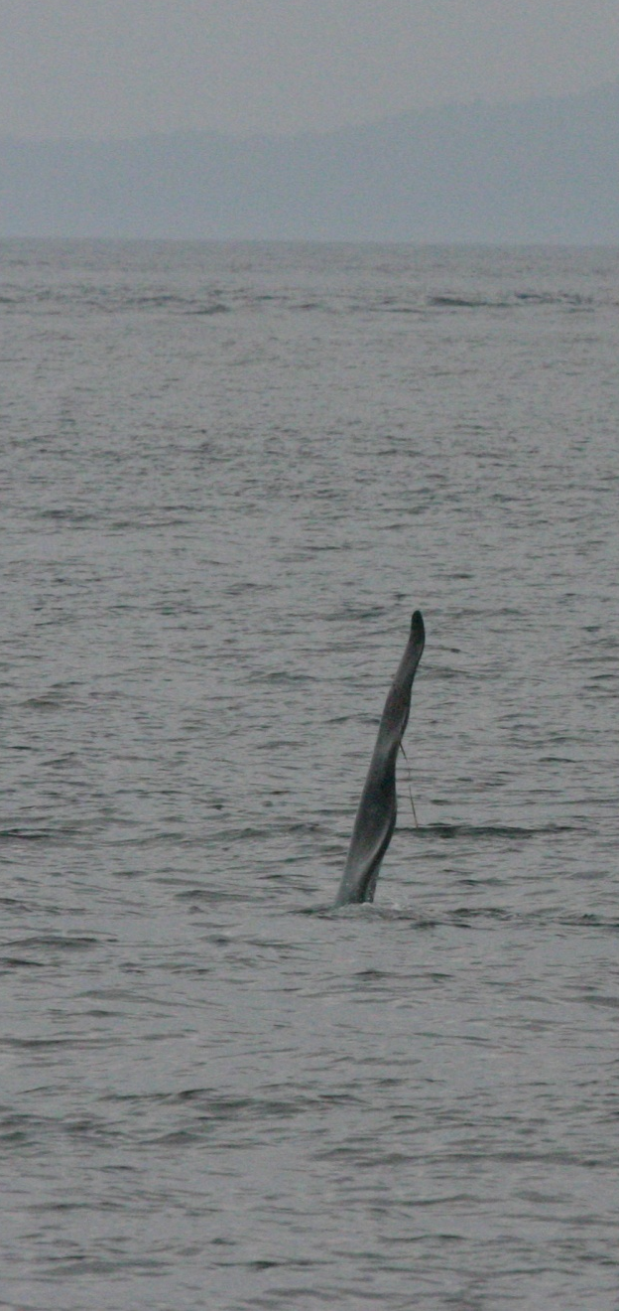
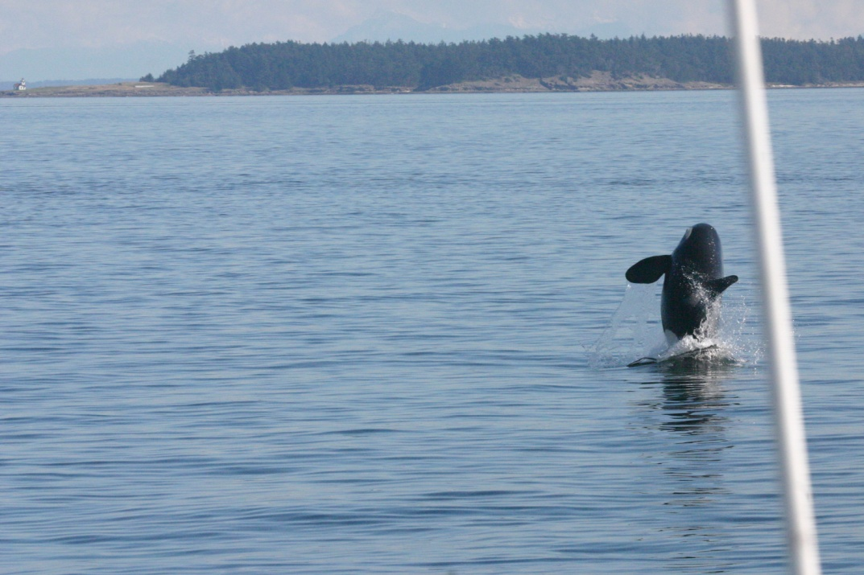
Hypothesis
There are recognizable physical variations of the call structure on the matrilineal level in the Southern Resident killer whale population.

Slide 5
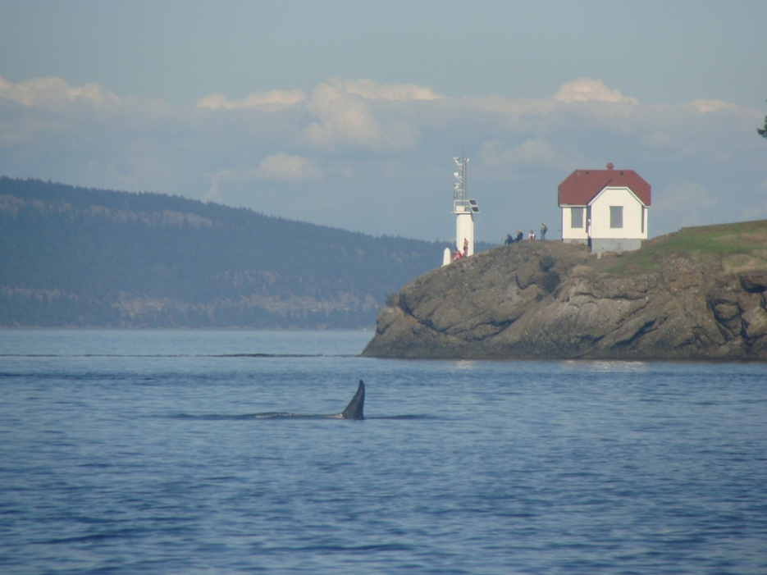
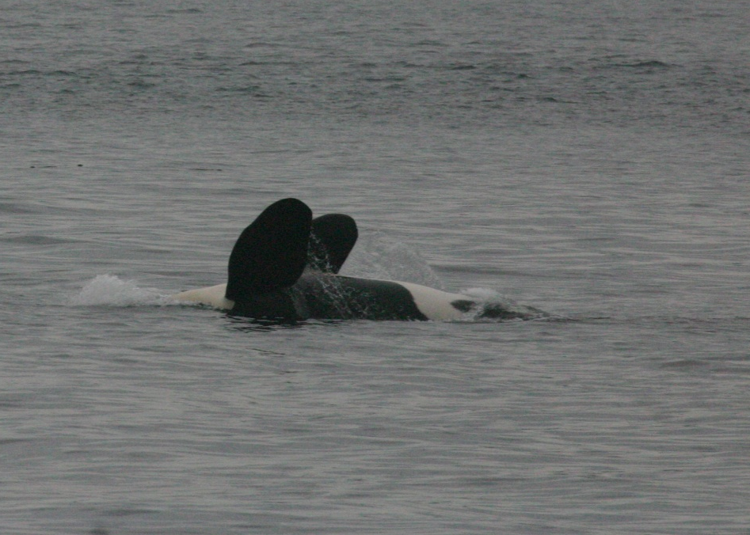
Data Collection
Acoustical recordings were made using a 4 hydrophone array and a high frequency hydrophone (CRT) towed behind the boat
Photos taken for identification
Observation of position of whales in orientation to the boat
Notes:
Data collection took place aboard the Gato Verde for 5 weeks in the Salish Sea
We had a 4 hydrophone array that was trailed about 50 meters behind the port stern, and a CRT about 20 meters off our starboard stern.
During data collection notes were taken about position with orientation to the boat, which Hana explained, every minute, and noted every minute a call was made

Slide 6
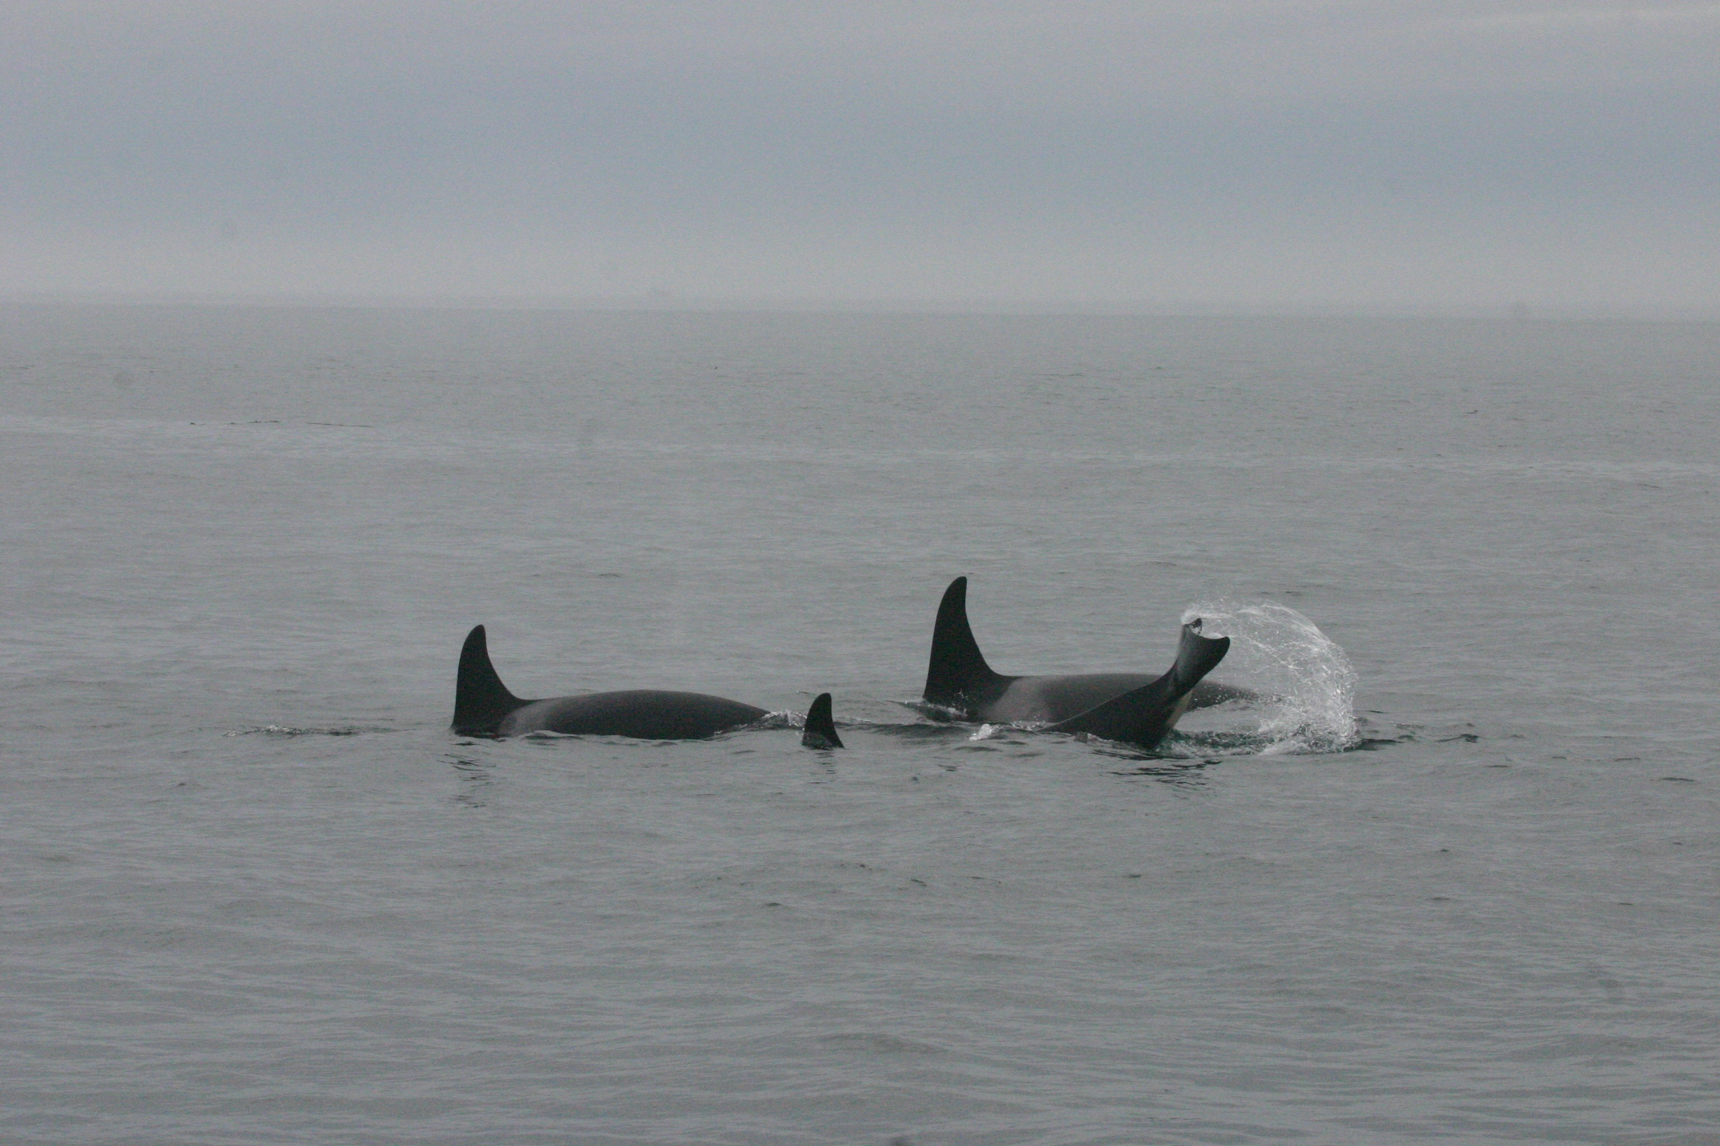
Data Analysis
Ishmael 1.0 used for localizing, finding call duration, and min/max frequencies
2009 Matriline Catalogue used for identification (Center for Whale Research)
Sea Sounds used to identify call types
Notes:
I used Ishmael in

Slide 7
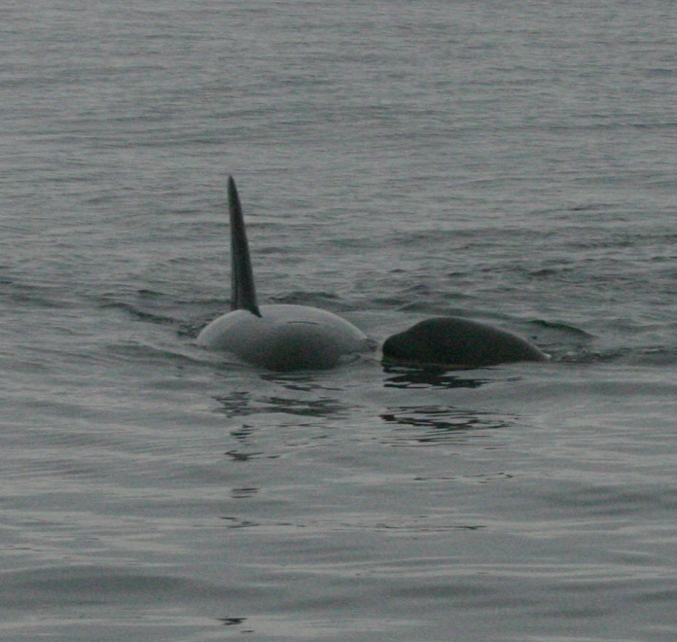
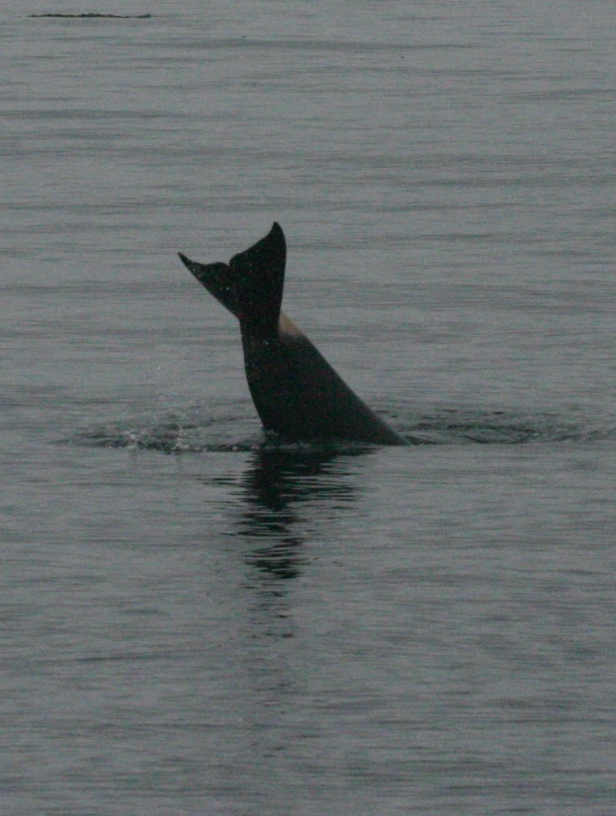
Results
Not enough data for statistical analysis
Compared call types between individuals
Compared average call durations to Ford’s (1987) average call durations

Slide 9

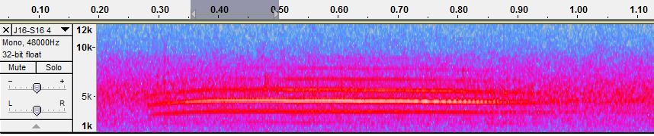
S16 Spectrogram

Slide 11
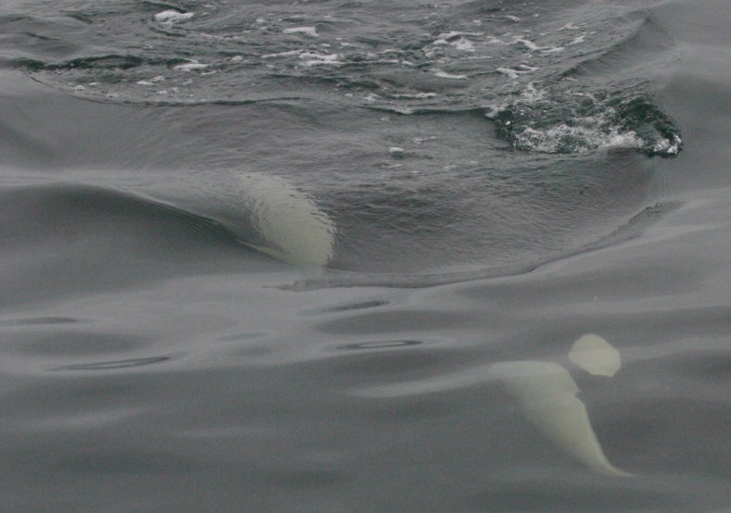
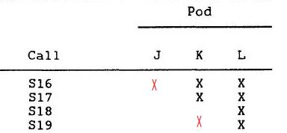
Interesting Findings
S16 made by J-pod
S19 made by other pods besides L

Slide 12
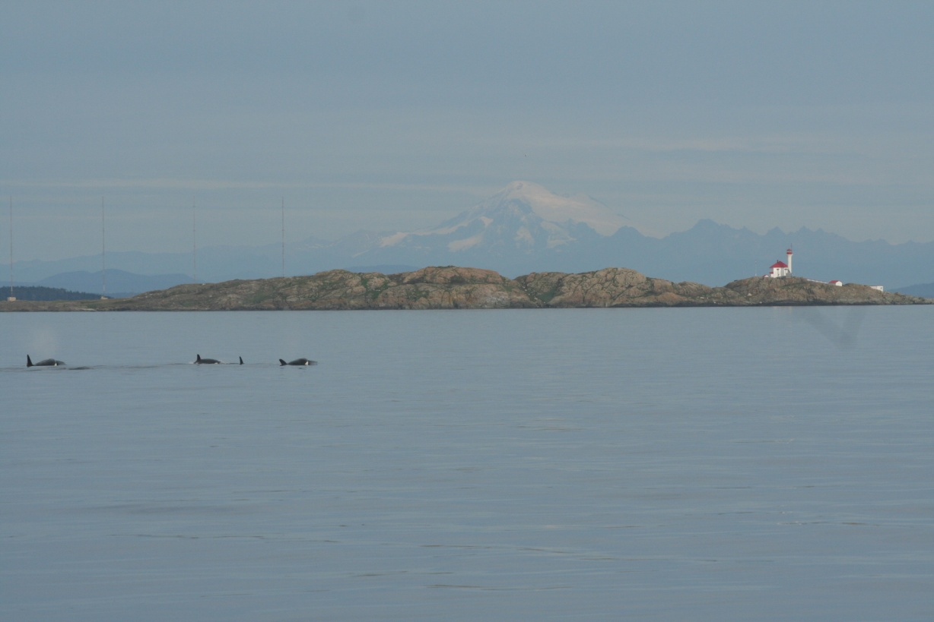
Further Research
Continuing this study for a longer period of time
Changes in calls
over time and social learning

Slide 13
Acknowledgements
I would like to thank:
Dr. Jason Wood, Dr. Val Veirs, Dr. Scott Veirs for all their help, having open minds to our projects, and dedication to our success.
Captain Todd Shuster for the use of the Gato Verde, teaching us how to sail, and putting your trust in us.
Cat Peters, Hana Kazunas, Garrett Turner, Dave Cade, and Vanessa Victoria for all your help, and making this experience so amazing!

Slide 14
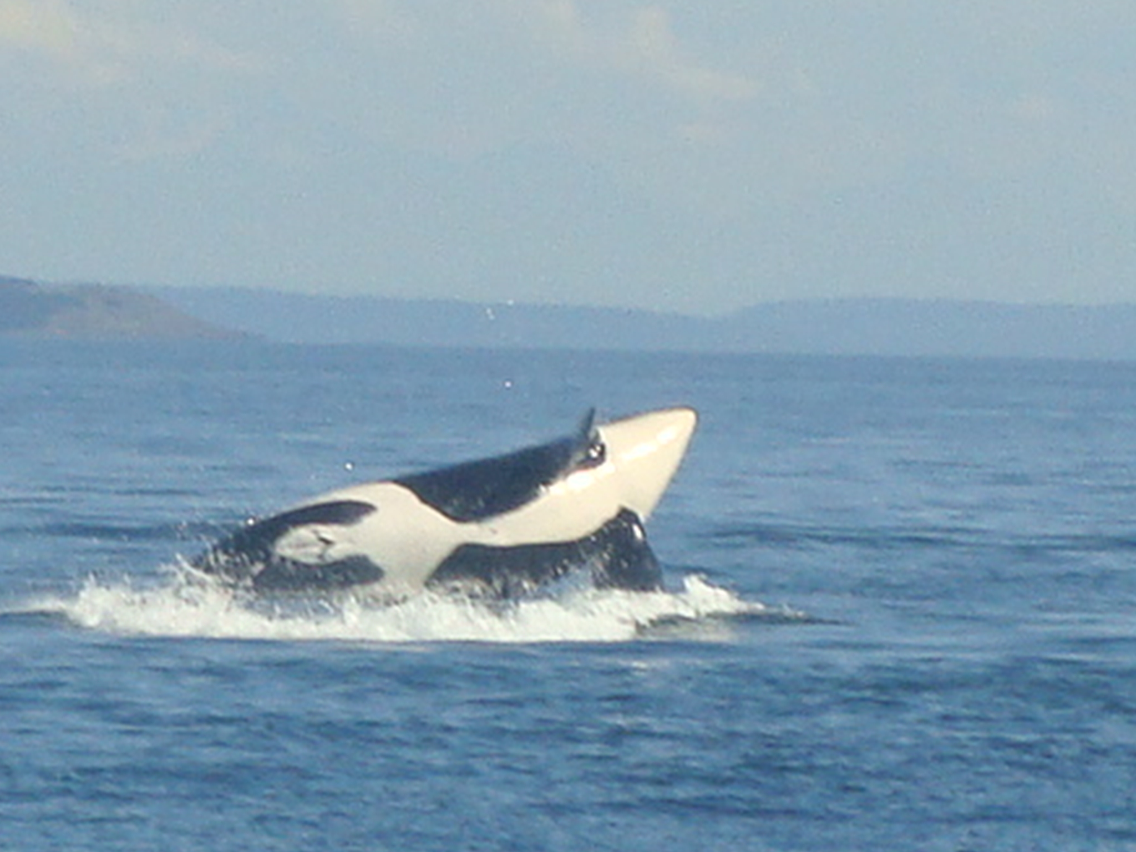
Thank you!
Questions?

